Slide 1
Sprint 2
Team 9

Slide 2
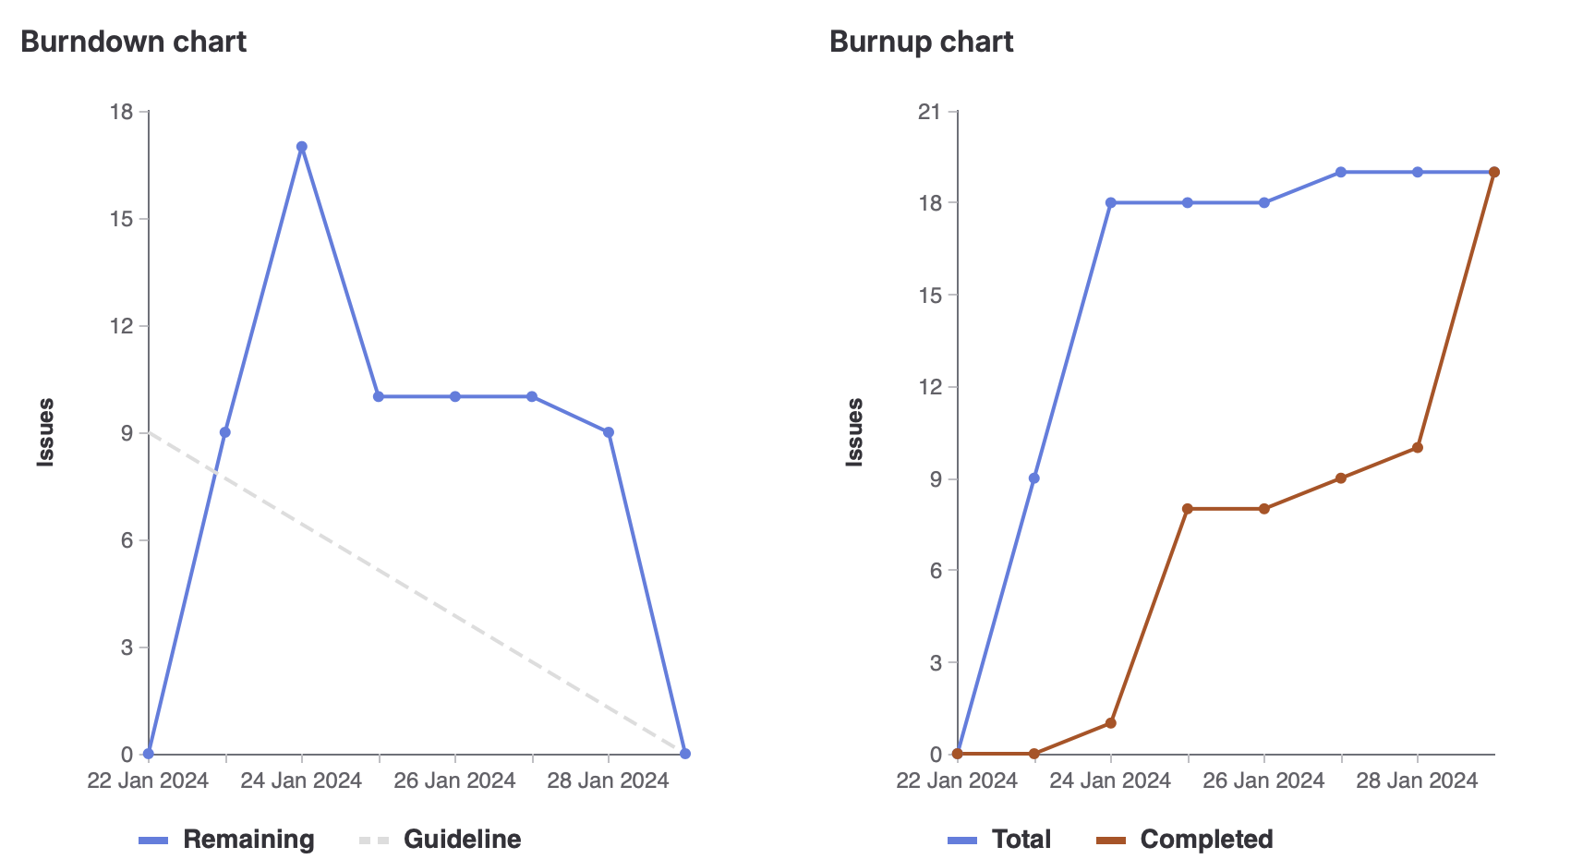
Milestone 2 Chart

Slide 3
Things To Improve:
Things Done Well:
Team organization, especially meeting times
Creating and assigning tasks earlier for burndown chart
Completion of transition from a full PHP application to Nextjs
Documenting each aspect of development in project wiki pages: Phaser, Socket.io, CICD
Tasks delegated and completed well

Slide 4
Karina
Phaser research
CI/CD implementation
Documentation (CI/CD wiki)
Designing the game/logic
Total: 16 weights

Slide 5
Muhammad
Phaser research/wiki
CI/CD (a lot of problems to resolve)
Game Design and logic
Total weight: 15 weights

Slide 6
Eric
Ci/CD with Karina
Joining and Creating rooms with Tehreem and Cavaari
Total Weights: 12

Slide 7
Cavaari Taylor
What I did this week:
Documentation
Designing the game/logic
Phaser research
Trying very hard to understand socket and creating and joining rooms
Challenges:
Understanding socket

Slide 8
Tehreem
Designing the game + game logic
Socket and create and joining rooms
Phaser + socket research
Total weights: 12

Slide 9
Egor
I took part in:
Nginx config for Next.js
Socket.io set up + Room demo
Phaser init scene
Read Me
Wiki
Challenges
Socket.io production

Slide 10
Kalindu
Node.js set up
Next.js initialization + setup
Phaser + socket research
Phaser set up
CI/CD build pipeline fix
Total weights: 12

